Slide 1
AI/ML for computer vision workshop
Notes:
Welcome and intro

Slide 2
Show of Hands
How many of you cannot write code?
How many of you are familiar with AI/ML/Deep Learning?
How many of you think using video to count cars or identify potholes is an easy problem?
ODOT Technology Conference 2022 TOGETHER TOWARDS TOMORROW

Slide 3
Goals
Learn how to solve Computer Vision problems
Use provided toolkit to experiment and …
Apply what you learned to solve your own problems
ODOT Technology Conference 2022 TOGETHER TOWARDS TOMORROW

Slide 4
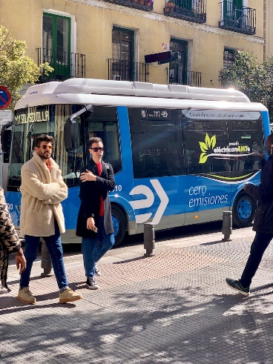
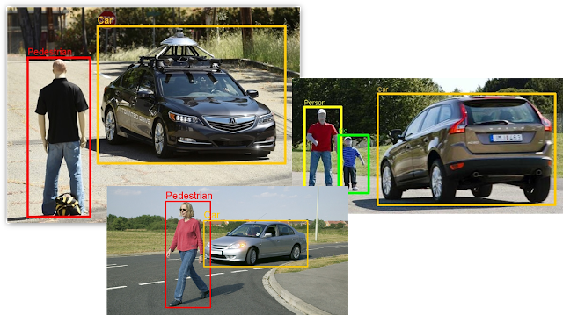
Classical Programming vs Machine learning
Input
Program/Trained
Output
Model
int
Square
(
int
i
C
l
)
assical
2
4
{
return
i
*
i
Programming
; }
Library of Trained
Bounding Boxes:
[[53.0, 399.0, 243.0,
Models
899.0], [15.0, 235.0, 790.0, 744.0], [666.0,
394.0, 809.0, 876.0], [221.0, 412.0, 350.0,
You may call code like
859.0], [0.0, 559.0, 76.0, 886.0]]
Machine
below
Confidence Scores:
[0.9052734375,
Learning
xyxy
,
0.90234375, 0.90185546875,
scores,class_ids
=
0.89208984375, 0.6181640625]
detector
.
detect
(ima
Classes:
[0, 5, 0, 0, 0]
ge)
Output is a Trained Model
Input
Deep Learning for Computer Vision

Slide 5

 | Input | Program/Trained Model | Output
Classical Programming | 2 | int Square(int i) {return i * i; } | 4
Machine Learning |  | Library of Trained Models You may call code like below xyxy, scores,class_ids = detector.detect(image) | Bounding Boxes: [[53.0, 399.0, 243.0, 899.0], [15.0, 235.0, 790.0, 744.0], [666.0, 394.0, 809.0, 876.0], [221.0, 412.0, 350.0, 859.0], [0.0, 559.0, 76.0, 886.0]] Confidence Scores: [0.9052734375, 0.90234375, 0.90185546875, 0.89208984375, 0.6181640625] Classes: [0, 5, 0, 0, 0]
Output
Input
Deep Learning for Computer Vision

Slide 6
Classical programming vs ML
ODOT Technology Conference 2022 TOGETHER TOWARDS TOMORROW

Slide 7
AI/ML/DL
1950’s
1980’s
2010’s
ODOT Technology Conference 2022 TOGETHER TOWARDS TOMORROW

Slide 8
QuizZ: DL, ML, AI or Classical Programming?
Lane Detection
https://youtu.be/OV1l5xFHiwQ?t=16
Path Planning
https://youtu.be/t7P4au6bT1Q?t=23
Vehicle Detection
https://youtu.be/kZViHcQgGYU?t=37
Behavioral Cloning
https://youtu.be/vXzgXb1rkjw?t=24

Slide 9
The Challenge
Images/video represent unstructured data that is hard to analyze and interpret automatically
How can we extract meaningful information from images/video?
ODOT Technology Conference 2022 TOGETHER TOWARDS TOMORROW

Slide 10
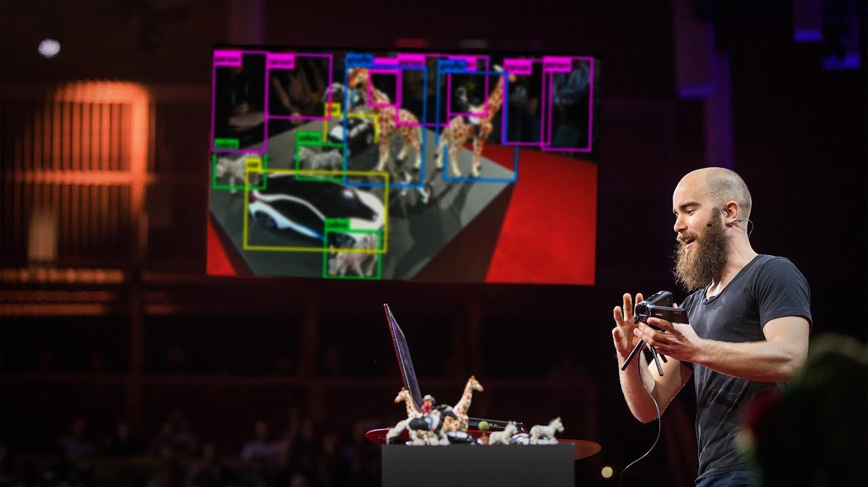
How computers learn to recognize objects
ODOT Technology Conference 2022 TOGETHER TOWARDS TOMORROW

Slide 11
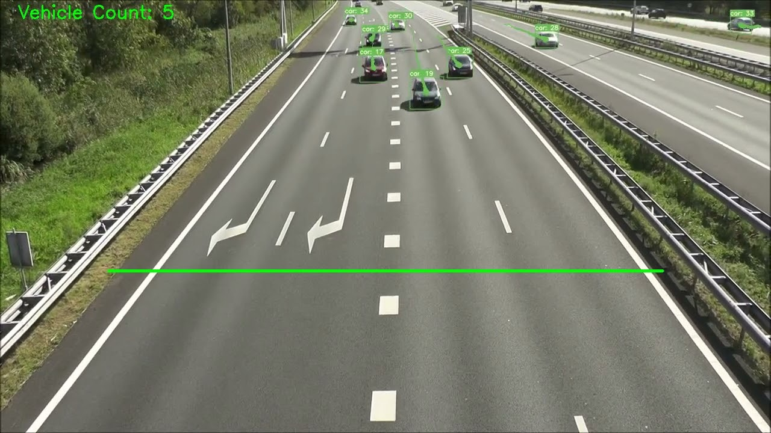
Our End Product
ODOT Technology Conference 2022 TOGETHER TOWARDS TOMORROW

Slide 12
Our End Product
YOLO
basic intro to YOLO
how it works
ODOT Technology Conference 2022 TOGETHER TOWARDS TOMORROW
12
ODOT Technology Conference 2022 TOGETHER TOWARDS TOMORROW

Slide 13
Let’s do some coding
Go to Google Colab and let’s have some fun
ODOT Technology Conference 2022 TOGETHER TOWARDS TOMORROW

Slide 14
Custom Model
Start with an existing training data set if you can find one
Train the model
Evaluate it
ODOT Technology Conference 2022 TOGETHER TOWARDS TOMORROW

Slide 15
Custom Model
Annotate your own data
Image annotations
Data format
ODOT Technology Conference 2022 TOGETHER TOWARDS TOMORROW

Slide 16
Active Learning
improve model over time
adapt to changes
ODOT Technology Conference 2022 TOGETHER TOWARDS TOMORROW

Slide 17
Some recent advances
Whisper
https://openai.com/blog/whisper/
ODOT Technology Conference 2022 TOGETHER TOWARDS TOMORROW

Slide 18
Some recent advances
Stable Diffusion
https://github.com/CompVis/stable-diffusion
ODOT Technology Conference 2022 TOGETHER TOWARDS TOMORROW

Slide 19
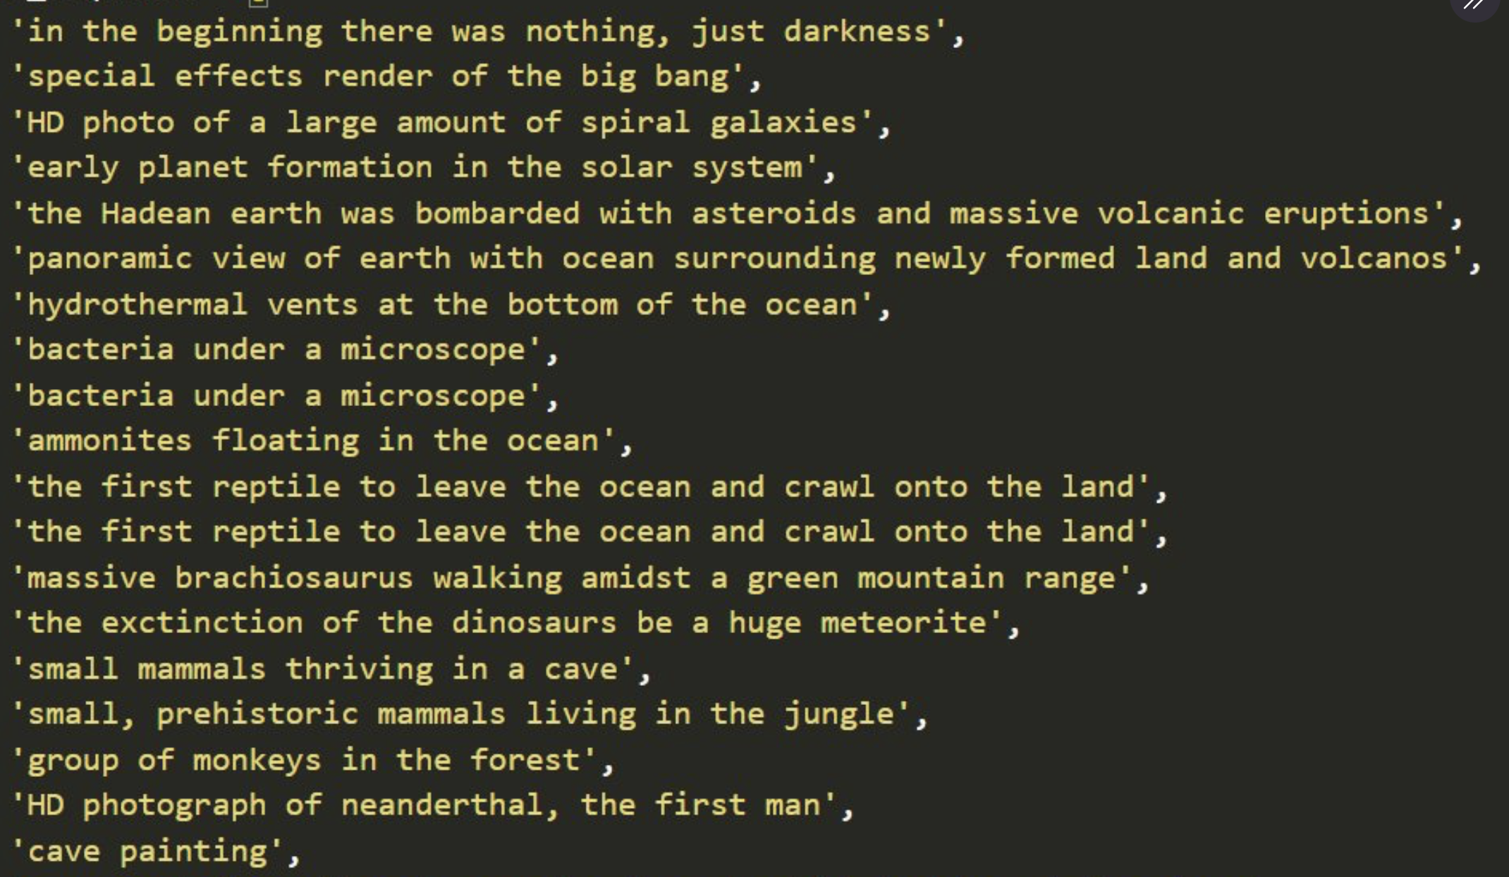
Stable Diffusion
https://twitter.com/xsteenbrugge/status/1558508866463219712
ODOT Technology Conference 2022 TOGETHER TOWARDS TOMORROW

Slide 20
Questions
?
Last updated 8/4/2022
ODOT Technology Conference 2022 TOGETHER TOWARDS TOMORROW

